Slide 1
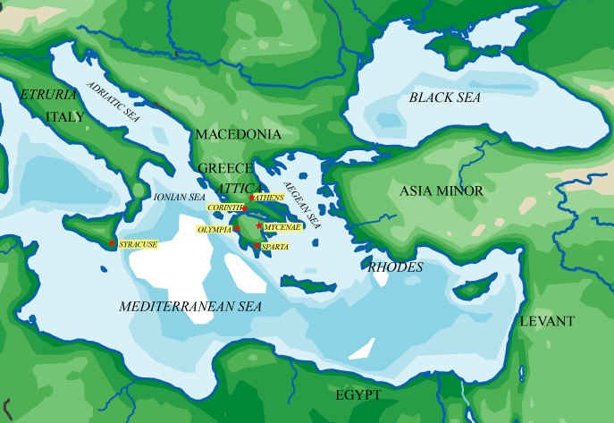
Located in southeastern Europe, Greece is defined by a series of mountains and surrounded on all sides except the north by water.
Notes:
Greece is the southeastern-most region on the European continent. It is defined by a series of mountains, surrounded on all sides except the north by water, and endowed with countless large and small islands. The Ionian and Aegean seas and the many deep bays and natural harbors along the coastlines allowed the Greeks to prosper in maritime commerce and to develop a culture which drew inspiration from many sources, both foreign and indigenous.

Slide 2
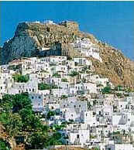
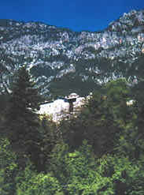
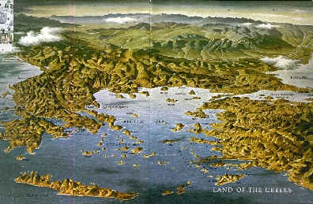
Numerous MOUNTAIN RANGES, which crisscross the peninsula, hampered internal communications and led to the development of independent city-states.
Numerous ISLANDS and the indented coastlines of the Greek peninsula and of Asia Minor stimulated a seagoing trade.
The ROCKY SOIL and limited natural resources encouraged the Greeks to establish colonies abroad.

Slide 3
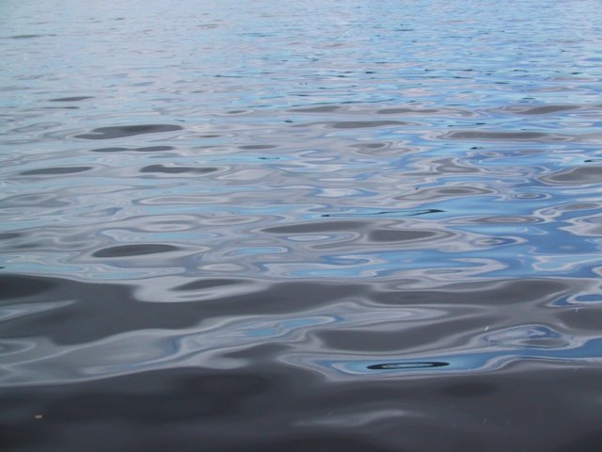
Role of bodies of water
Main source of food through fishing industry
Most important routes for trade and travel will be the seas
Military will depend on sailing the seas to expand the Greek empire
Communication

Slide 4
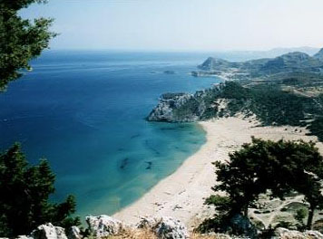
The Mediterranean Sea moderates Greece's climate, cooling the air in summer and providing warmth in the winter months. Summers are generally hot and dry. Winters are moderate and rainy in coastal regions and cold and snowy in mountainous areas.
Notes:
The Mediterranean Sea moderates Greece´s climate, cooling the air in summer and providing warmth in the winter months. Summers are generally hot and dry. Winters are moderate and rainy in coastal regions and cold and snowy in mountainous areas.

Slide 5
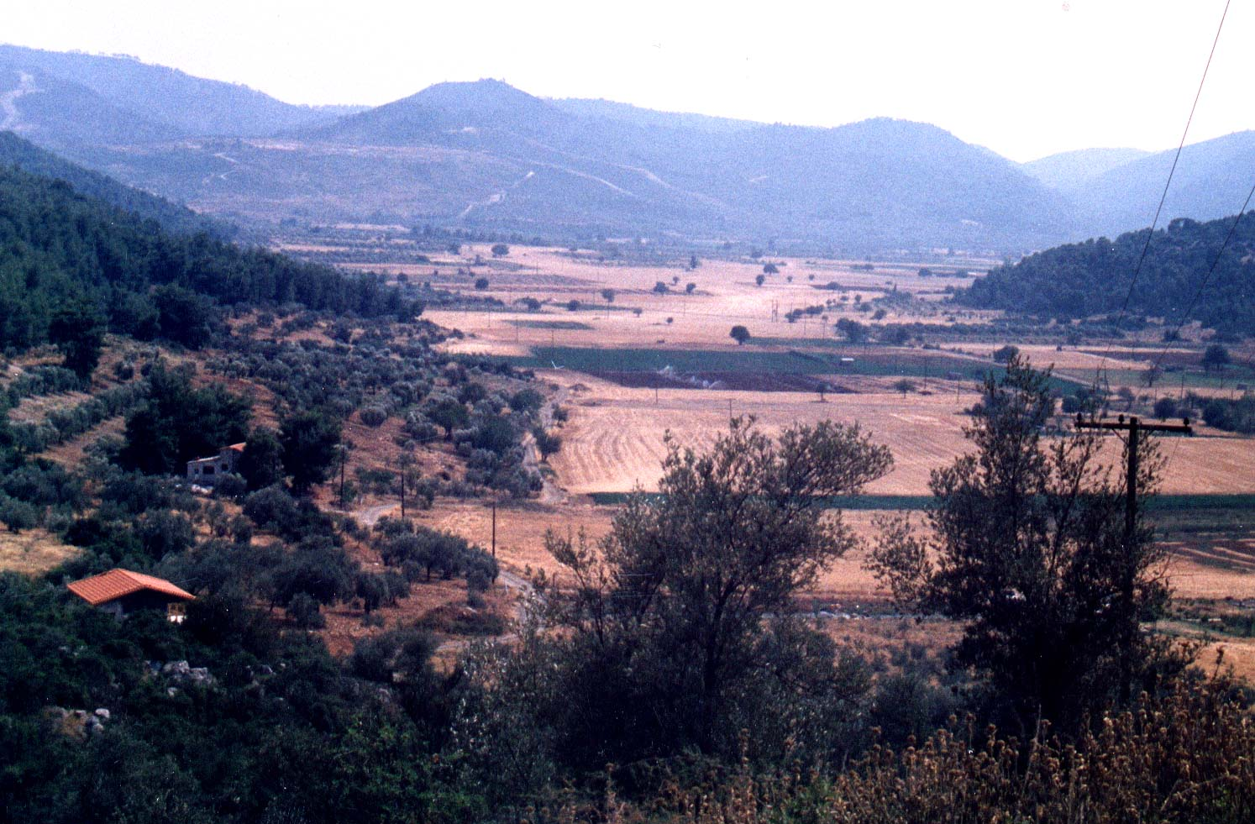
Geographic factors played an important role in Greek history.
Notes:
The mountains, which served as natural barriers and boundaries, dictated the political character of Greece. From early times the Greeks lived in independent communities isolated from one another by the landscape. Later these communities were organized into poleis or city-states. The mountains prevented large-scale farming and impelled the Greeks to look beyond their borders to new lands where fertile soil was more abundant.

Slide 6
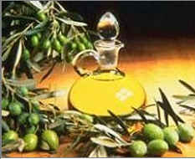
ECONOMIC CONDITIONS were those of a simple, self-sufficient agricultural system. CROPS: The Greeks used OLIVES for eating and to make olive oil, used for cooking and as a lubricant. They made wine from GRAPES. The common drink of everyone was a mixture of wine and water. Even children drank it. Dionysius, the mythological god of the vine, oversaw and blessed everything having to do with growing grapes and making wine. BARLEY was used to make bread and was a staple part of the Greek diet. Demeter was the mythological goddess of grain. LIVESTOCK: The ancient Greeks kept CHICKENS, PIGS, SHEEP, and GOATS (for milk and meat). They would only eat the meat of animals who had been sacrificed in the name of a god. Generally, they did not eat a lot of meat, but instead depended upon FISH and LEGUMES (beans, chickpeas, and lentils) for protein.

Slide 7
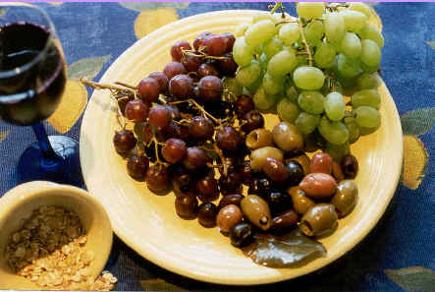
The daily diet included CEREALS (like wheat and barley), GRAPES, and OLIVES -- commonly called the MEDITERRANEAN TRIAD.
The Greeks typically made grapes into WINE and olives into OLIVE OIL, so they would keep without refrigeration. Grains and cereals were commonly used for BREAD and PORRIDGE.
Diets were supplemented with VEGETABLES and HERBS from kitchen gardens as well as BERRIES, and MUSHROOMS. The poor usually ate FISH, while oysters, sea urchins, octopus, and eels were considered DELICACIES and only eaten by the wealthy.

Slide 8
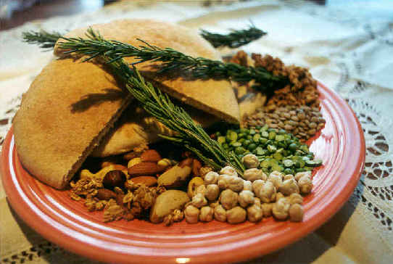
BREAD in ancient Greece was a very important part of the daily diet. At first all breads were prepared in the embers of a fire. Eventually the Greeks developed a bread OVEN that is similar in function to the ovens we use today. Because they required less wood or charcoal (which was expensive), these ovens made bread AVAILABLE TO ALMOST EVERYONE.
The most common type of bread in Greece was called MAZA which was a flat bread made from barley flour. Most meals consisted of maza and some sort of accompaniment to the bread called OPSON. This might be vegetables, fish, olives, onions, garlic, fruit, and on a rare occasion, meat.

Slide 9
Olive Oil
Most valuable Greek product was olive oil
Good for cooking
Good for flavoring food
Used for lamp fuel
Used for body lotion
Greeks sold the Olive Oil to get other goods that they could not produce

Slide 10
Impact of Geography
Advantages
Disadvantages
Protection
Easy to trade
Solid fishing industry
Specialized crops- grapes, olives, etc.
Excellent for sailing
Difficult for agriculture
Tough to travel across land
Inconsistent climate
Very spread out
Few rivers

