Slide 1
Geography Vocab

Slide 2
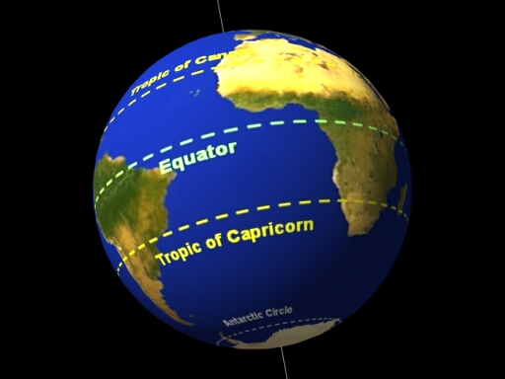
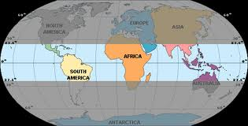
equator-
0 degrees... hot climate- splits the world into N and S

Slide 3
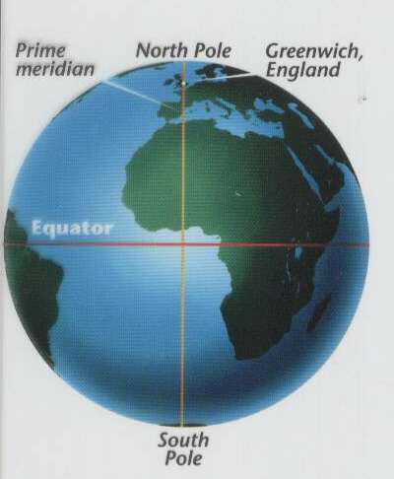
prime meridian-
0 degrees--- connects the poles through England- splits the world into E and W

Slide 4
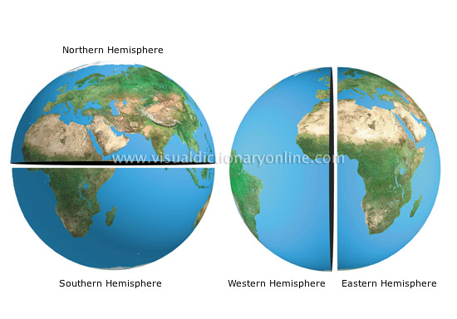
hemisphere
hemi means half/ sphere is 3-D shape like the globe...the world can be split into 4 hemispheres....N, S, E, W

Slide 5
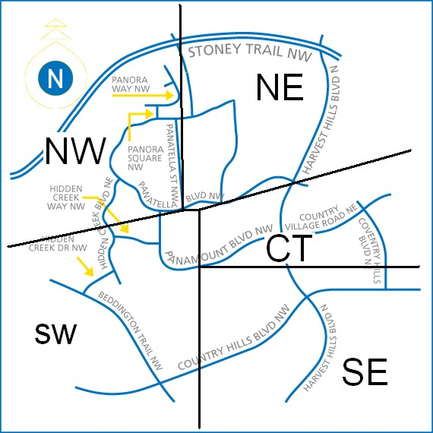
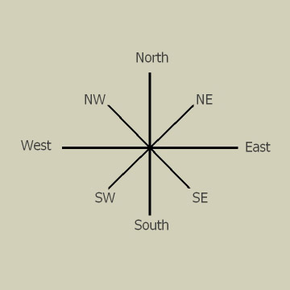
quadrant
- quad means four... the world can be split into NW, SW, SE, NE...

Slide 6
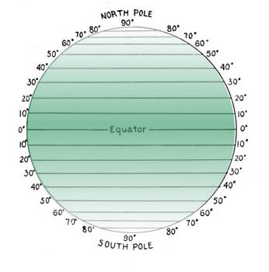
Latitude or parallels -
imaginary lines on the Earth that help measure distance- "fatitude" like the world's belt....equator is an example....

Slide 7
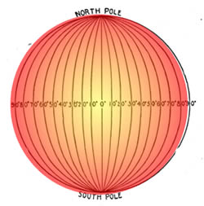
Longitude or meridians-
imaginary lines on the Earth that help measure distance- These lines go up and down but measure east to west.. Prime Meridian is an example

Slide 8
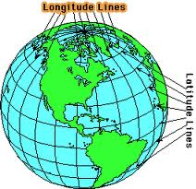
absolute location-
“grid address” latitude and longitude lines together
Relative location is in relation to some other place, “Hansen’s is next door to Walmart”

Slide 9
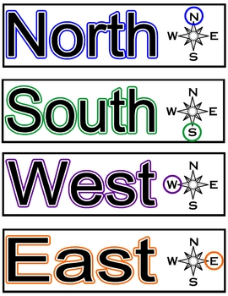
cardinal directions-
main directions- N, S, E, W

Slide 10
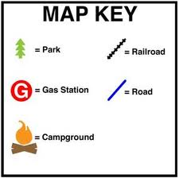
Legend or map key-
tells you what symbol on the map stands for

Slide 11
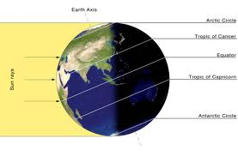
Tropic of Cancer
Tropic of Cancer-
Northern tropic line that marks the highest point of direct sunlight
in the Northern hemisphere’s summer

Slide 12
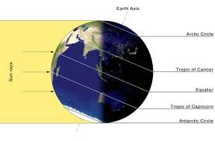
Tropic of Capricorn
Tropic of Capricorn-
Southern tropic line that marks the lowest point of direct sunlight
in the Northern hemisphere’s winter

