Slide 1
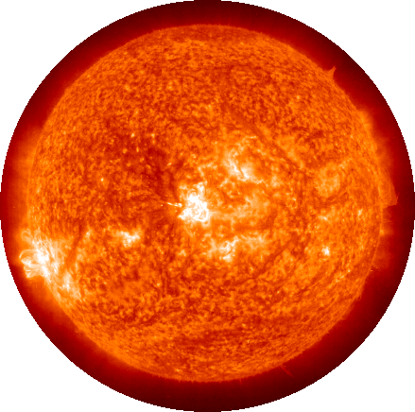
Diameter: 1,391,000 km (864,400 mi)
Day (rotation): 26.8 Earth days
Number of moons: 0
Rings: 0
Solid or Gas
Sun

Slide 2
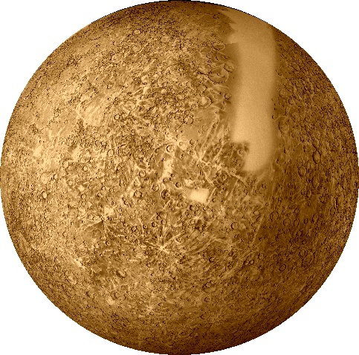
Diameter: 4,880 km (3,032 mi)
Day (rotation): 58.65 Earth days
Distance from sun: 57.91 million km
35.98 million mi
Year (revolution): 87.97 Earth days
Number of moons: 0
Rings: 0
Solid or Gas
Mercury

Slide 3
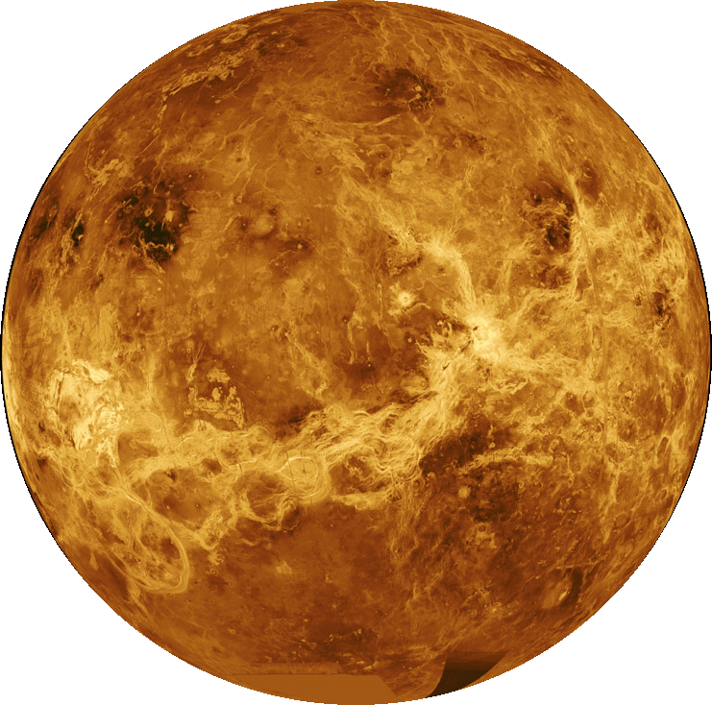
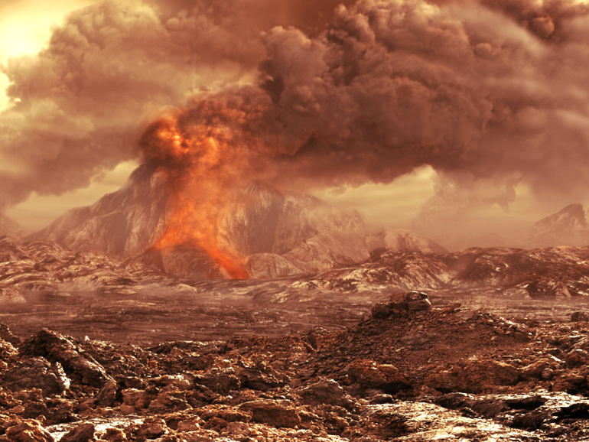
Diameter: 12,104 km (7,520 mi)
Day (rotation): 243.02 Earth days
Distance from sun: 108.21 million km
67.24 million mi
Year (revolution): 224.70 Earth days
Number of moons: 0
Rings: 0
Solid or Gas
Venus

Slide 4
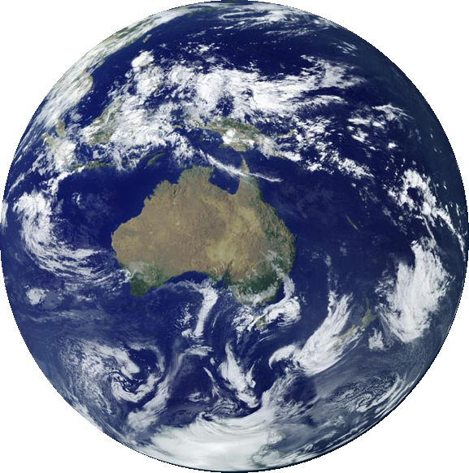
Diameter: 12,756 km (7,926 mi)
Day (rotation): 23.93 hours
Distance from sun: 149.60 million km
92.96 million mi
(1 Astronomical Unit = 1 AU)
Year (revolution): 365.26 days
Number of moons: 1
Rings: 0
Solid or Gas
Earth

Slide 5
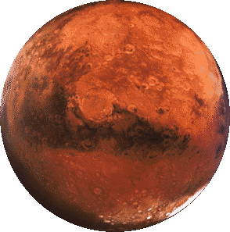
Diameter: 6,794 km (4,222 mi)
Day (rotation): 24.62 hours
Distance from sun: 227.94 million km
141.63 million mi
Year (revolution): 1.8807 Earth years
686.98 Earth days
Number of moons: 2
Rings: 0
Solid or Gas
Mars

Slide 6
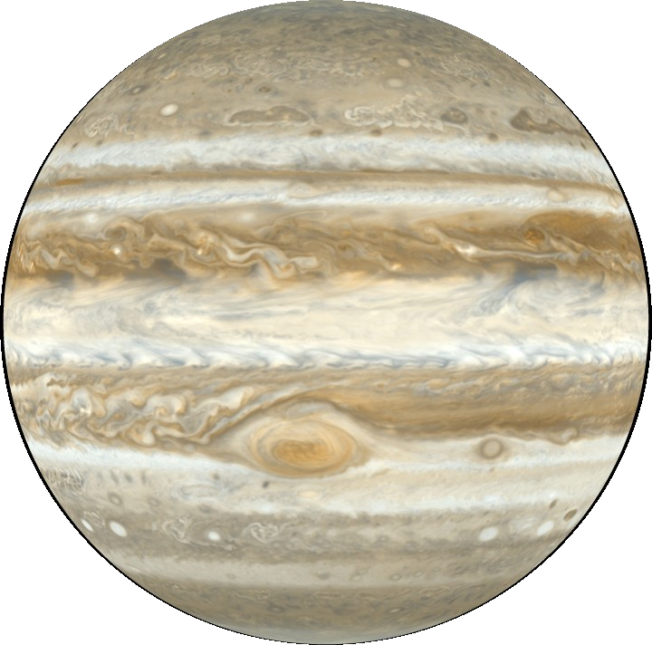
Diameter: 142,984 km (88,846 mi)
Day (rotation): 9.92 Earth hours
Distance from sun: 57.91 million km
35.98 million mi
Year (revolution): 87.97 Earth days
Number of moons: 49 (now 63)
Rings: 1
Solid or Gas
Jupiter
Notes:
As of Feb 14, 2011, Jupiter has 63 confirmed moons.

Slide 7
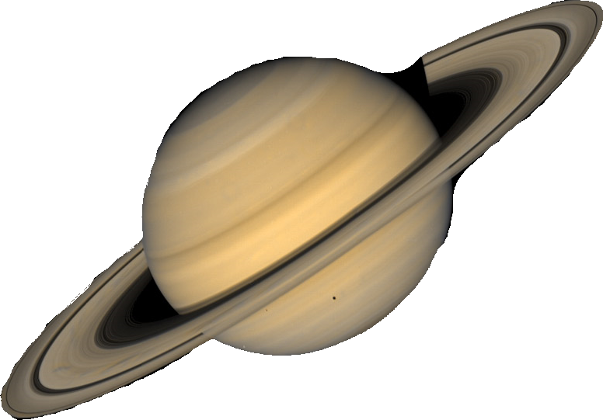
Diameter: 120,536 km (74,898 mi)
Day (rotation): 10.656 Earth hours
Distance from sun: 1,426.73 million km
886.53 million mi
Year (revolution): 29.4 Earth years
10,755.7 Earth days
Number of moons: 62
Rings: 7
Solid or Gas
Saturn

Slide 8
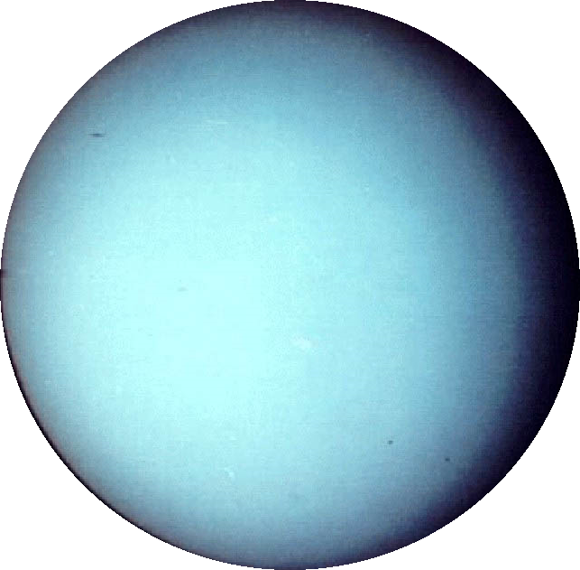
Diameter: 51,118 km (31,764 mi)
Day (rotation): 17.24 Earth hours
Distance from sun: 2,870.97 million km
1,783.94 million mi
Year (revolution): 84.02 Earth years
30,687.2 Earth days
Number of moons: 27
Rings: 13
Solid or Gas
Uranus

Slide 9
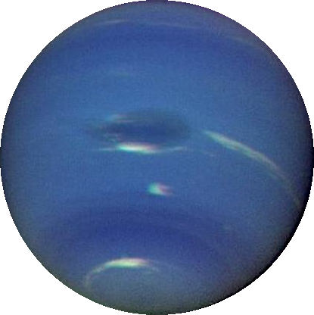
Diameter: 49,528 km (30,776 mi)
Day (rotation): 16.11 Earth hours
Distance from sun: 4,498.25 million km
2,795.08 million mi
Year (revolution): 164.79 Earth years
60,190 Earth days
Number of moons: 13
Rings: 6
Solid or Gas
Neptune

Slide 10
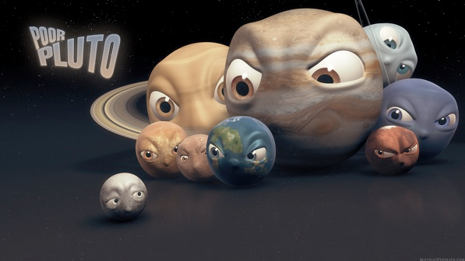
Notes:
In August 2006, the IAU voted on a definition of planet: 1. Had to be spherical from its own gravity 2. Had to be in orbit around the Sun (not around another planet) 3. Had to have cleared its orbital path of debris
Pluto met the first 2 criteria, but didn't meet the 3rd - Pluto's orbit takes it into the Kuiper (rhymes with VIPER) Belt, which has thousands of small objects (debris).
If Pluto were discovered today, no one would even consider calling it a planet because it's clearly a Kuiper-belt object.

Slide 11
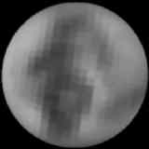
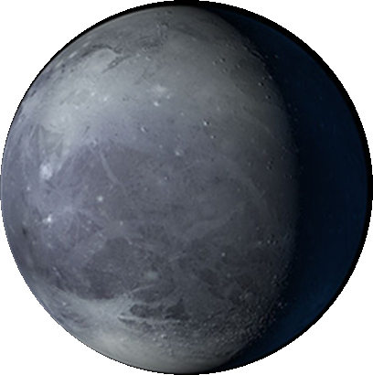
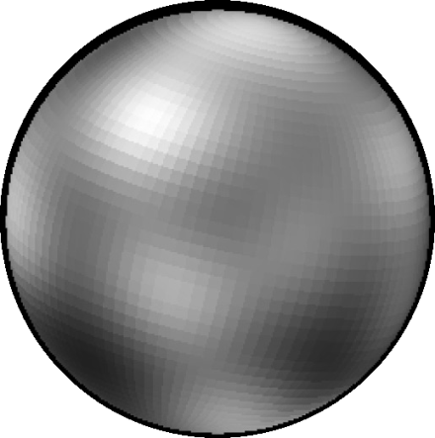
Diameter: 2,360 km (1,466 mi)
Day (rotation): 6.387 Earth days
Distance from sun: 5,906.38 million km
3,670.05 million mi
Year (revolution): 247.92 Earth years
90,553 Earth days
Number of moons: 3
Rings: 0
Solid or Gas
Pluto
Notes:
(left) actual photographs of Pluto taken by the Hubble Space Telescope
(right) An artist’s impression of what Pluto may look like.

